Slide 1
NY city bike July 2022
File created on: 2/5/2024 1:20:41 AM

Slide 2
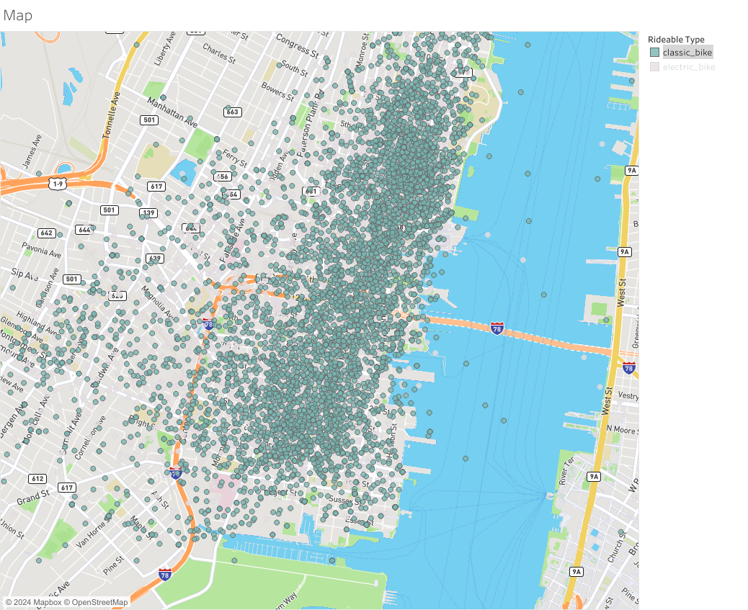

Slide 3
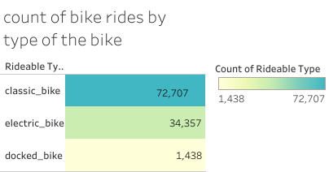

Slide 4
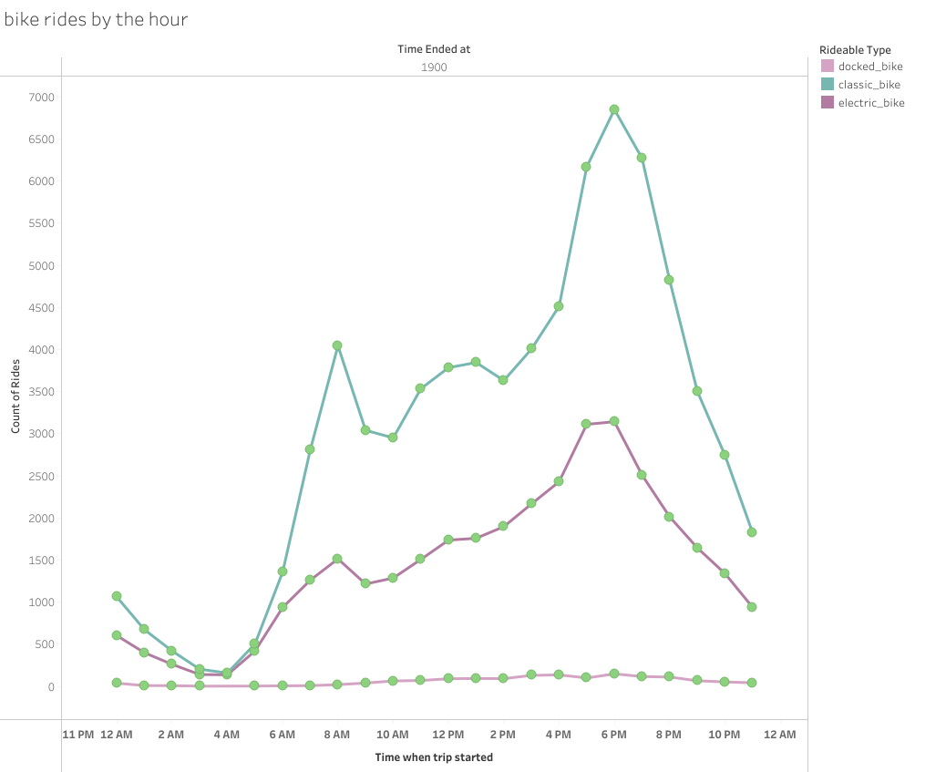

Slide 5
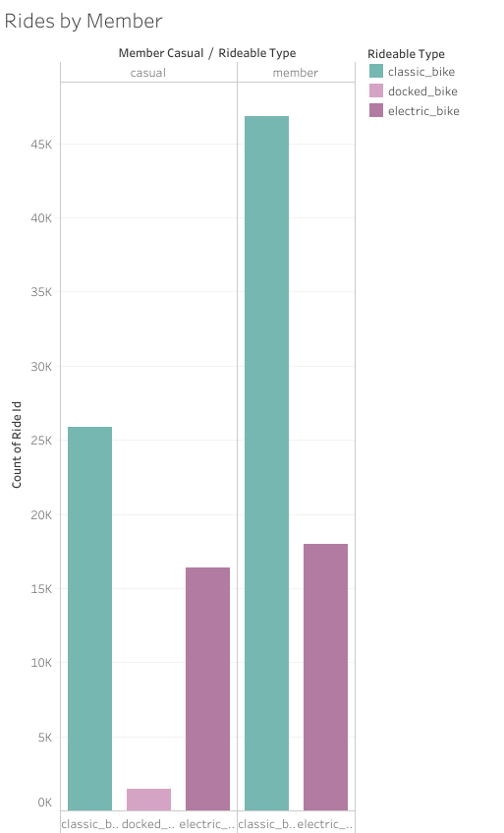

Slide 6
